Slide 1
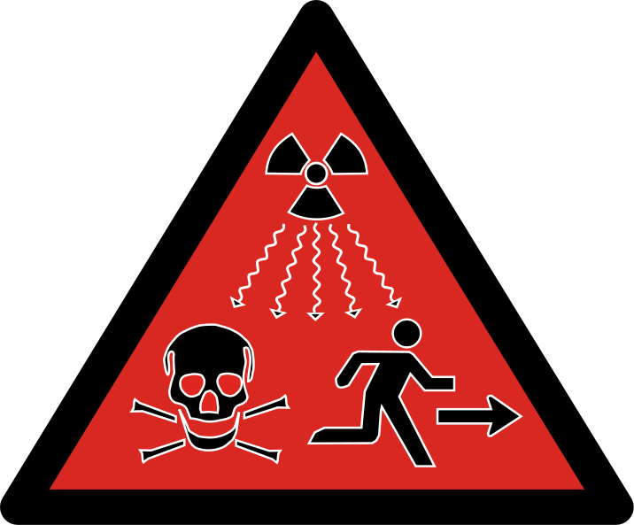
Radiation Physics

Slide 2
ACTIVITY
Radiation activity refers to the amount of radiation released from unstable nucleus per unit time.
Activity provides information on the radiation emitted to the environment in the per unit time.
In addition, Activity can be considered as disintegration rate of the unstable nucleus.
Because the radiation activity is proportional to the amount of radiation released from unstable nucleus, it is very important to know this information.

Slide 3
There are 2 different units of radiation activity.
One of them is Curie, the traditional unit, and the other is Becquerel, the unit in the international system.
1 gram radium (Ra-226) generates 3.7*10¹⁰ disintegration per second (dps).
This value (3.7*10¹⁰ dps) is defined as one Curie (Ci).
One Curie refers to quite large amount of radiation.
The lower radiation level is used in the health area, especially nuclear medicine.
Small activity amounts such as mili Curie (mCi) and Micro Curie in (µCi) the health area are used.

Slide 4
1 mCi = 3.7 × 10⁷ disintegration per second (dps)
1 Ci = 3.7 × 10⁴ disintegration per second (dps)
Becquerel (Bq) is the international system (SI) of unit of radiation activity.
One Bq is equal to 1 disintegration per second (dps).
One Bq refers to quite small amount of radiation.
The larger radiation level is especially used in the health area like mega Becquerel (MBq) and giga Becquerel (GBq).

Slide 5
1 MBq = 10⁶Bq 1GBq = 10⁹Bq.
The relationship between Becquerel and Curie is as follows.
1 Ci = 3.7 x 10¹⁰Bq
The relationship between Becquerel and Curie is practically used as follows.
1 mCi = 37 MBq
Activity refers to a measure of the amount of radiation released from the radioactive substance.
This unit does not express the dose of radiation transferred to other substance, air or biological systems.

Slide 6
EXPOSURE
Exposure is a term used in explaining the amount of ionization in which X rays and gamma rays are in the air.
Exposure is the sum of the electrical charges that X and gamma rays produce at standard pressure and dry air at standard temperature.
The exposure unit is Coulomb per kilogram in the international system (SI). It is also used Rontgen as exposure unit.
Roentgen (R) is defined as 2.58*10⁻⁴ C/kg of dry air at standard temperature and pressure.

Slide 7
1R = 2.58*10⁻⁴ C/kg
The concept of exposure is not used for particulate radiations.
This concept is used only for x and gamma rays, which are electromagnetic radiation.
The charge and mass used in the definition of this concept only refer to the charge and mass of air.

Slide 8
ABSORBED DOSE
The concept of exposure is used to measure for electromagnetic radiation energy in the air.
This concept is quite practical for air.
However this concept is not used for material other than air.
A new concept is needed for the radiation exposure of materials.
The most important concept in determining the amount of radiation to which the material is exposed is the absorbed dose.
Absorbed dose is simply the radiation dose absorbed per unit mass of any material.

Slide 9
When any material is exposed to direct or indirect ionizing radiation, in most cases, some of the radiation energy can be absorbed by the material.
The other part of the energy escapes from the volume of interest.
This escaping energy is absorbed elsewhere in the matter.
Now some definitions must be made here.
R_{in} is the radiation energy entering the volume of interest.
R_{out} is the radiation energy escaping from the volume of interest.
ΣQ is the sum of the mass-energy changes resulting from interactions in the volume of interest.
After these definitions, the average energy imparted to the volume of interest can be written as follows.
Ɛ_{tr}=R_{in}-R_{out}+ ΣQ

Slide 10
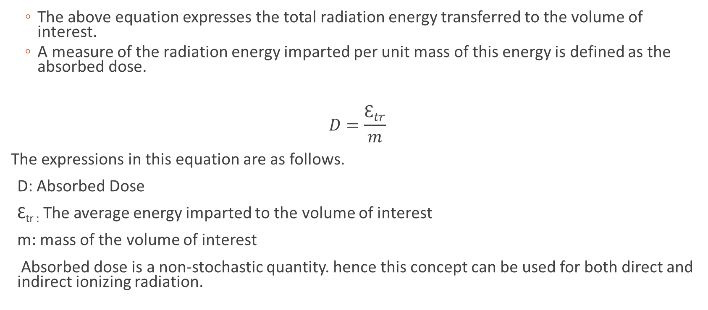
The above equation expresses the total radiation energy transferred to the volume of interest.
A measure of the radiation energy imparted per unit mass of this energy is defined as the absorbed dose.
$$D=\frac{Ɛ_{tr}}{m}$$
The expressions in this equation are as follows.
D: Absorbed Dose
Ɛ_{tr :} The average energy imparted to the volume of interest
m: mass of the volume of interest
Absorbed dose is a non-stochastic quantity. hence this concept can be used for both direct and indirect ionizing radiation.

Slide 11
There are 2 units of absorbed dose.
One of them is the special unit rad. Rad was originally expressed as 100 erg/g.
later it was used in the SI unit system. In the SI system, 1 rad is defined as 10-2 joule/kg.
As the international use of the SI unit system became widespread, a new unit was needed for the absorbed dose.

Slide 12
At the General Conference on Weights and Measures, it was agreed to use the Gray unit for the unit of absorbed dose.
While the special unit rad continues to be used in some countries today, its use has been completely abolished in some countries.
The conversions of absorbed dose units to each other are as follows.
1 rad=100 erg/g
1 rad =10⁻² j/kg
1 gray=1 j/kg
1gray =100 rad

Slide 13
EQUIVALENT DOSE
The concept of absorbed dose is a very useful for determining the radiation exposure of the material.
However in biological systems, the same amount of absorbed dose from different types of radiation produces different degrees of damage.
For example, the damage done by 1 gray alpha rays to the biological system is not the same as 1 gray gamma ray.
It has been determined that the damage caused by 1 gray alpha to the biological system is equal to the damage done by 20 Gray alpha rays.

Slide 14
In order to determine the damage caused by radiation to a biological systems, the type of radiation must be considered.
For this, the radiobiological effects of radiation types should be used.
The radiobiological effect varies according to the types of radiation.
The coefficient that determines the damage caused by the radiation type to the biological system is called the radiation weighting factor (w_{R}).
Radiation weighting factor is showed in table.

Slide 15
The equivalent dose (H) is calculated by multiplying the absorbed dose by the radiation weighting factor (w_{R}).
There are two unit of equivalent dose.
One of them special unit rem.
Rem refers to roentgen equivalent man.
The unit of equivalent dose in the international system is Sievert (Sv).
If the absorbed dose value is used in gray unit and multiplied by the radiation weight factor, the equivalent dose is calculated from the Sieverd unit.
If the absorbed dose value is used in rad unit and multiplied by the radiation weight factor, the equivalent dose is calculated from the rem unit.
Calculations are made as follows

Slide 16
Equivalent dose, H (Sv) = absorbed dose (Gy) * w_{R}
H(Sv)=D(Gy)*w_{r}
Equivalent dose, H (rem) = absorbed dose (rad) * w_{R}
H(rem)=D(rad)*w_{r}
1 Sv =100 rem

Slide 17
Table : Radiation weighting factor of some radiation types
Type of radiation | Radiation weighting factor
X rays | 1
Gamma rays | 1
Electrons | 1
Protons | 5
Alpha particle | 20
Thermal neutrons | 2.5
Fast neutrons | 2.5-20 (Depending on energy)

Slide 18
X, gamma rays and electrons are generally used for diagnosis and treatment in medical physics departments in hospitals.
Since the radiation weighting factor of these 3 radiation type is 1, the numerical value of the absorbed dose and the equivalent dose is the same.

Slide 19
effective dose
The sensitivity of organs and tissues to radiation is different from each other.
For example, the sensitivity of the gonads is very high, while the sensitivity of the bones surface is less.
For this reason, a new concept was needed in determining the radiation exposure to each organ.
This new concept is called effective dose.
The effective dose is calculated by multiplying the equivalent doses given to the whole body by the tissue weight factor (w_{t}).
Tissue weight factors vary according to organs and tissues, some of them are shown in the table.

Slide 20
Effective dose (Sv)= Equivalent dose, H (Sv)* tissue weight factor (w_{t})
E(Sv)=H(Sv)*w_{t}
Effective dose (rem)= Equivalent dose, H (rem)* tissue weight factor (w_{t})
E(rem)=H(rem)*w_{t}

Slide 21
Tissue weighting factor of some tissue
Tissue | Tissue Weighting Factors (w_{t})
Gonads | 0.20
Lung | 0.12
Colon | 0.12
Bone marrow | 0.12
Stomach | 0.12
Thyroid | 0.05
Breast | 0.05
Oesophagus | 0.05
Liver | 0.05
Bladder | 0.05
Bone surface | 0.01
Skin | 0.01
Remainder | 0.05
Total Body | 1.00

